Slide 1


Fadhil Reza Maulana
December, 12 2022

Slide 2

Outline
Executive Summary
Introduction
Methodology
Results
Conclusion
Appendix

Slide 3
Executive Summary
Summary of methodologies
Summary of all results

Slide 4
Introduction
Project background and context
Problems you want to find answers

Slide 5

Section 1

Slide 6
Methodology
Executive Summary
Data collection methodology:
Data collected use SpaceX API and scrapping from Wikipedia
Perform data wrangling
Data was encoded by one hot encoding and was sclaed
Perform exploratory data analysis (EDA) using visualization and SQL
Perform interactive visual analytics using Folium and Plotly Dash
Perform predictive analysis using classification models
How to build, tune, evaluate classification models

Slide 7
Data Collection – SpaceX API
Get Request SpaceX API
Present your data collection with SpaceX REST calls using key phrases and flowcharts
Add the GitHub URL of the completed SpaceX API calls notebook (must include completed code cell and outcome cell), as an external reference and peer-review purpose
SpaceX API Data Collection Github URL
Normalize json
Convert to Dataframe
Stored to Dataframe

Slide 8
Data Collection - Scraping
Get Request HTML Falcon9 Page
Present your web scraping process using key phrases and flowcharts
Add the GitHub URL of the completed web scraping notebook, as an external reference and peer-review purpose
Falcon9 HTML Web Scrapping GitHub URL
Create BeautifulSoup Object
Extract column and variable
Create dict and Stored to Dataframe

Slide 9
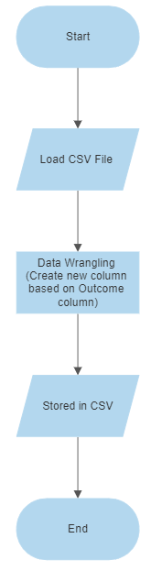
Data Wrangling
Describe how data were processed
Data Wrangling GitHub URL

Slide 10
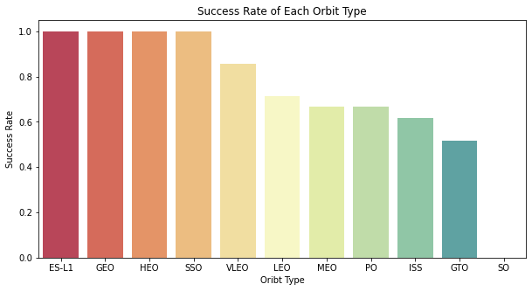
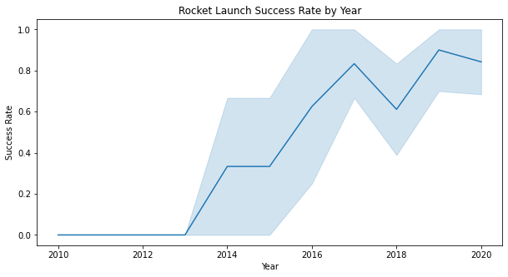
EDA with Data Visualization
Both chart show us which Orbit Type and Year with the highest success rate
EDA Data Viz GitHub URL

Slide 11
EDA with SQL
Using bullet point format, summarize the SQL queries you performed
Add the GitHub URL of your completed EDA with SQL notebook, as an external reference and peer-review purpose

Slide 12
Build an Interactive Map with Folium
Summarize what map objects such as markers, circles, lines, etc. you created and added to a folium map
Explain why you added those objects
Add the GitHub URL of your completed interactive map with Folium map, as an external reference and peer-review purpose
Folium EDA GitHub URL

Slide 13
Build a Dashboard with Plotly Dash
Summarize what plots/graphs and interactions you have added to a dashboard
Explain why you added those plots and interactions
Add the GitHub URL of your completed Plotly Dash lab, as an external reference and peer-review purpose

Slide 14
Predictive Analysis (Classification)
Summarize how you built, evaluated, improved, and found the best performing classification model
You need present your model development process using key phrases and flowchart
Add the GitHub URL of your completed predictive analysis lab, as an external reference and peer-review purpose

Slide 15
Results
Exploratory data analysis results
Interactive analytics demo in screenshots
Predictive analysis results

Slide 16

Section 2

Slide 17
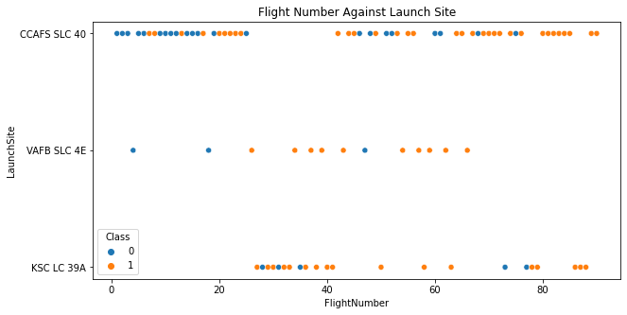
Flight Number vs. Launch Site
Show a scatter plot of Flight Number vs. Launch Site
Show the screenshot of the scatter plot with explanations
From the plot we can see that most Flight Number from all LaunchSite was successfully landed

Slide 18
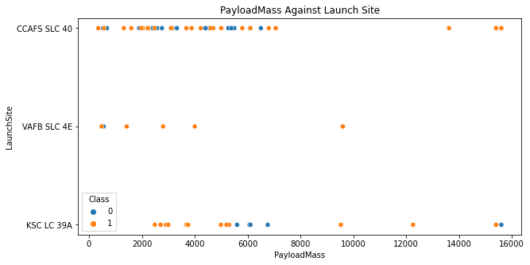
Payload vs. Launch Site
Show a scatter plot of Payload vs. Launch Site
Show the screenshot of the scatter plot with explanations
From plot we can see that Launch Site ‘CCAFS SLC 40’ is launchsite with the highest landing failure for Falcon9 with Payload under 6000 Kg

Slide 19
Success Rate vs. Orbit Type
Show a bar chart for the success rate of each orbit type
Show the screenshot of the scatter plot with explanations
Graph above show us that ES-L1 orbit type has the highest success rate than other orbit type

Slide 20
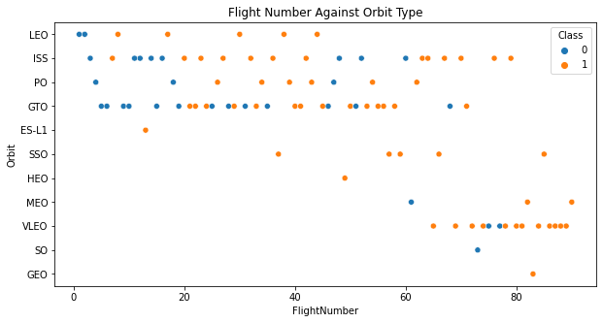
Flight Number vs. Orbit Type
Show a scatter point of Flight number vs. Orbit type
Show the screenshot of the scatter plot with explanations
VLEO orbit type become the most successful orbit with the highest rate of flight number

Slide 21
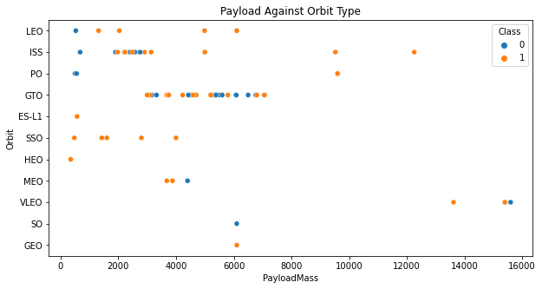
Payload vs. Orbit Type
Show a scatter point of payload vs. orbit type
Show the screenshot of the scatter plot with explanations
VLEO become an Orbit with flight payloadmass over 12000 Kg

Slide 22
Launch Success Yearly Trend
Show a line chart of yearly average success rate
Show the screenshot of the scatter plot with explanations
From the plot above we can see that The success rate from rocket launch each year is mostly increase, exceptional form year 2017 to 2018 there’s slightly decreseasing.

Slide 23
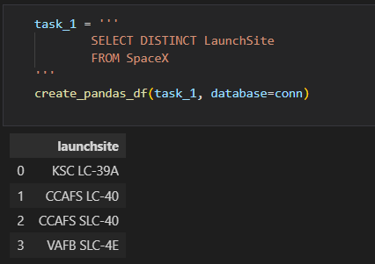
All Launch Site Names
Find the names of the unique launch sites
Present your query result with a short explanation here
With Distinct from LaunchSite column we can get unique value from that column. And now we get there are 4 unqieu Launch Site Name

Slide 24
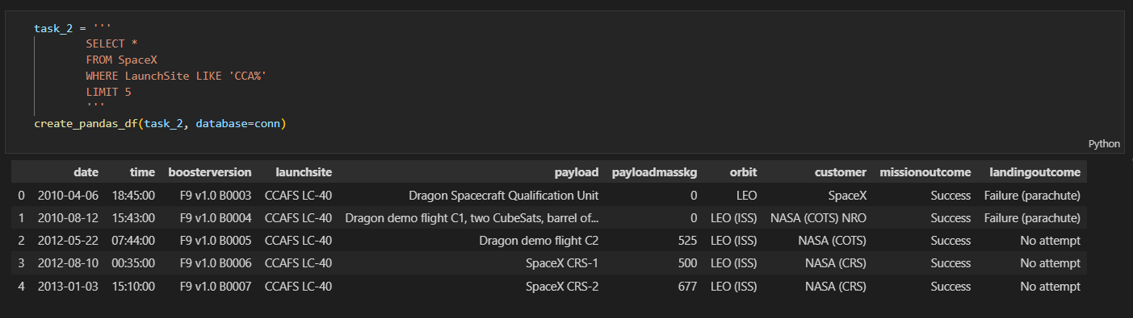
Launch Site Names Begin with 'CCA'
To get top 5 Launch Site Name that begin with CCA we use LIKE and limit to only 5 query result

Slide 25
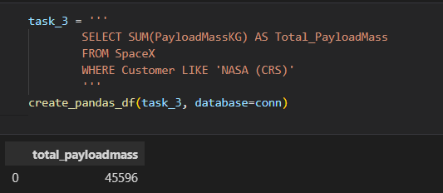
Total Payload Mass
To get Total Payload carried by NASA we use SUM on PayloadMassKg and use like filter on Customer column

Slide 26
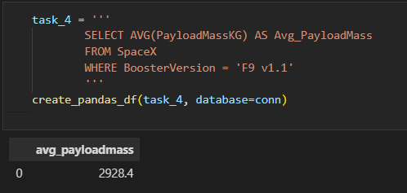
Average Payload Mass by F9 v1.1
Calculate the average payload mass carried by booster version F9 v1.1
Query above show us how to get avg payload mass that carried by booseter version F9 v1.1

Slide 27
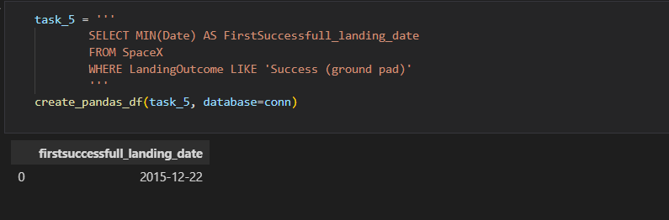
First Successful Ground Landing Date
Find the dates of the first successful landing outcome on ground pad
To find the first successful landing that means we have to query the minum date that exist in this database. So we have to use MIN on Date column and use like filter on landingoutcome column to have value Success (ground pad)

Slide 28
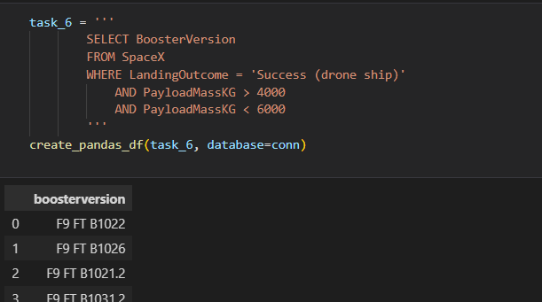
Successful Drone Ship Landing with Payload between 4000 and 6000
List the names of boosters which have successfully landed on drone ship and had payload mass greater than 4000 but less than 6000
Use filter on landing outcome and payloadmasskg with value over 4000 and under 6000

Slide 29
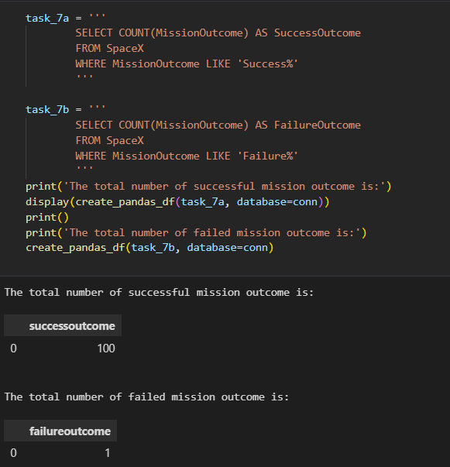
Total Number of Successful and Failure Mission Outcomes

Slide 30
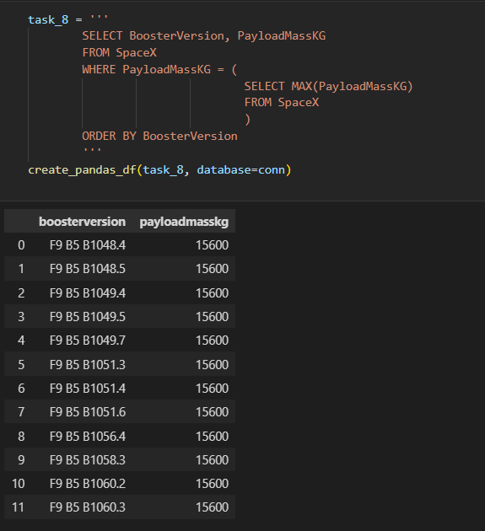
Boosters Carried Maximum Payload

Slide 31
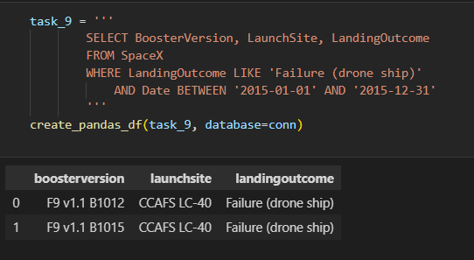
2015 Launch Records

Slide 32
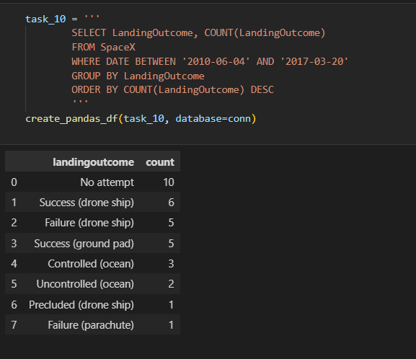
Rank Landing Outcomes Between 2010-06-04 and 2017-03-20

Slide 33

Section 3

Slide 34
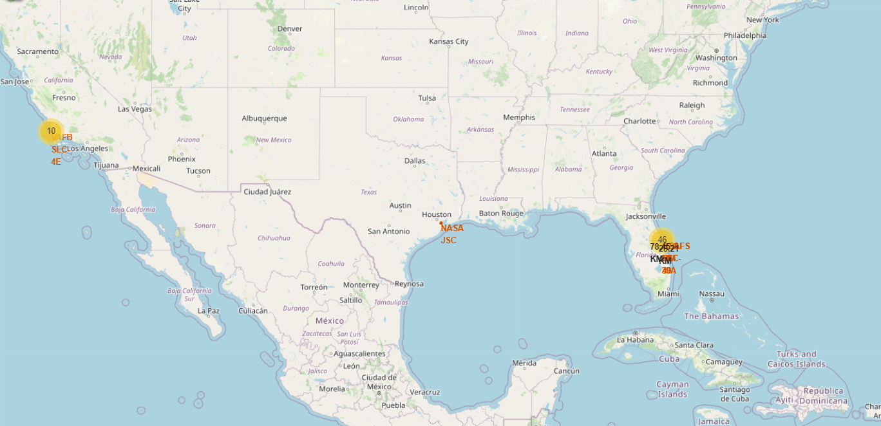
Rocket Launch Site Location

Slide 35
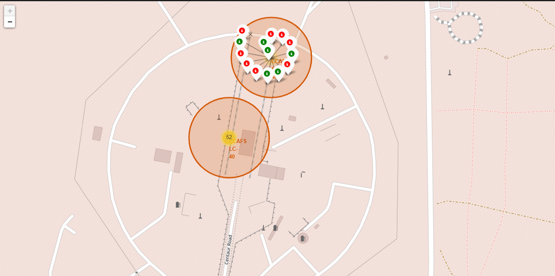
CCAFS ALC-40 Launch Site Marker Color
Maps above show us the coordinate of CCAFS ALC-40 Launch Site. Green markers indicates a successful landing and the red markers indicates an unsuccessful landing

Slide 36
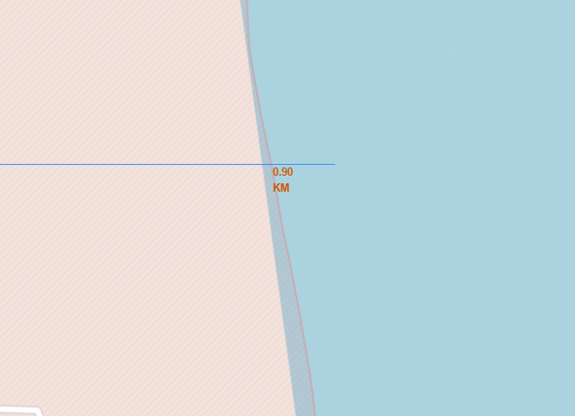
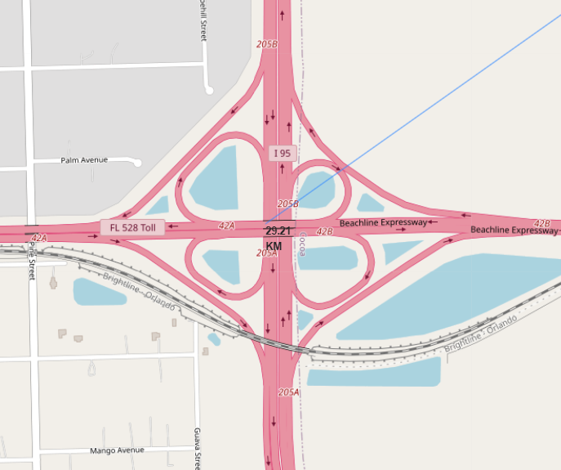
Launch Site Location Distance to Public Places
Distance to Coastline
Distance to Highway
Are launch sites in close proximity to railways? No
Are launch sites in close proximity to highways? No
Are launch sites in close proximity to coastline? Yes
Do launch sites keep certain distance away from cities? Yes

Slide 37

Section 4

Slide 38
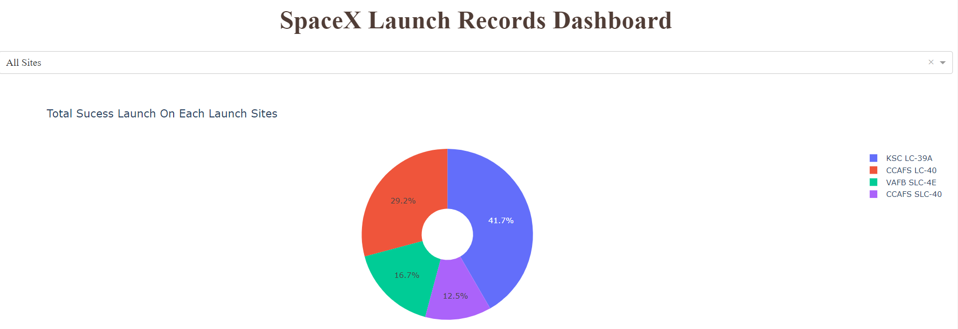
Total Success Launch on Each Launch Site
From chart above,KSC LC-39A is the most successful launch site, with success rate around 41 %, and CCAFS SLC-40 launch site with the lowest success rate with 12, 5 %

Slide 39
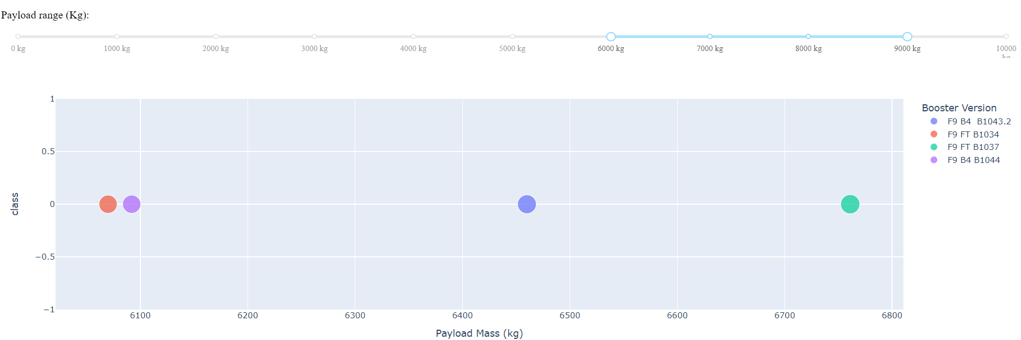
Booster Version Success Rate Based on Payload Mass (kg)
For rocket launch with Payload mass around 60.000 Kg – 90.000 Kg. we can see that all the Booster Version had failed all the launches.

Slide 40
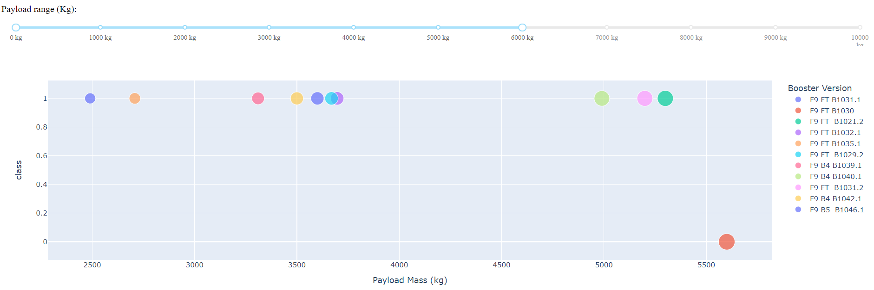
Booster Version Success Rate Based on Payload Mass (kg)
For rocket launch with Payload mass under 5500 Kg. we can see that all the Booster Version had succeed all the launches

Slide 41

Section 5

Slide 42
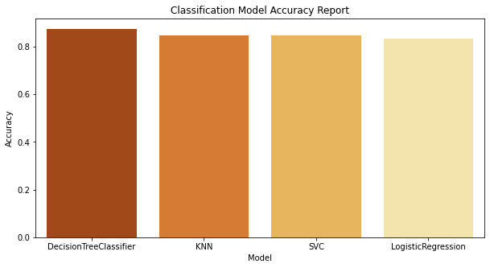
Classification Accuracy
From the plot beside, we can see that in this dataset,
DecisionTreeClassifier is the best
model with the best accuracy result

Slide 43
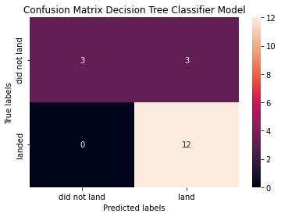
Confusion Matrix
This model has the highest accuracy among other algorithm, and it can be proved by this confusion matrix beside. the model only made 3 prediction errors, which predicting the rockets that didn't land that did actually it was landed.

Slide 44
Conclusions
Launch Site ‘CCAFS SLC 40’ is launchsite with the highest landing failure for Falcon9 with Payload under 6000 Kg
that ES-L1 orbit type has the highest success rate than other orbit type
VLEO orbit type become the most successful orbit with the highest rate of flight number
The success rate from rocket launch each year is mostly increase

Slide 45
Appendix
Include any relevant assets like Python code snippets, SQL queries, charts, Notebook outputs, or data sets that you may have created during this project

Slide 46


